Slide 1
Checking and securing understanding of plotting coordinates generated from a rule
Graphical representations of linear equations

Slide 2
how to use Oak lessons

Slide 3
I can represent, algebraically and graphically, a set of coordinates constructed according to a mathematical rule.

Slide 4
An arithmetic (or linear) sequence is a sequence where the difference between successive terms is a constant.
Example: 6, 11, 16, 21, … has a constant difference of +5 therefore it is arithmetic (linear).
Non-example: 1, 2, 4, 8, … does not have a constant difference therefore it is not arithmetic, it is non-linear.

Slide 5

Checking and securing understanding of plotting coordinates generated from a rule
Plotting arithmetic sequences
Plotting coordinates that follow a rule

Slide 6



Plotting arithmetic sequences
Which arithmetic sequence is bigger?
2n
n + 2
I think 2n because multiplication is more powerful than addition.
I think both can be the bigger one.
Who do you agree with?
Aisha is correct. 2n could be the bigger one, n + 2 could be the bigger one. It depends on the value of n.
Aisha
Sofia

Slide 7
Plotting arithmetic sequences
Find the first five terms of the arithmetic sequences:
2n
n + 2
Term number (n) | 1 | 2 | 3 | 4 | 5
Term value (T)
Term number (n) | 1 | 2 | 3 | 4 | 5
Term value (T) | 2
Term number (n) | 1 | 2 | 3 | 4 | 5
Term value (T) | 2 | 4
Term number (n) | 1 | 2 | 3 | 4 | 5
Term value (T) | 3
Term number (n) | 1 | 2 | 3 | 4 | 5
Term value (T)
When n = 1
2n = 2(1) = 2 × 1 = 2
When n = 1
n + 2 = (1) + 2 = 3
When n = 2
2n = 2(2) = 2 × 2 = 4

Slide 8
Plotting arithmetic sequences
Find the first five terms of the arithmetic sequences:
2n
n + 2
Term number (n) | 1 | 2 | 3 | 4 | 5
Term value (T) | 2 | 4 | 6 | 8 | 10
Term number (n) | 1 | 2 | 3 | 4 | 5
Term value (T) | 3 | 4 | 5 | 6 | 7
2n : 2, 4, 6, 8, 10, …
n + 2 : 3, 4, 5, 6, 7, …
For the first term n + 2 is bigger. For the second term they are equal.
For the first term n + 2 is bigger.
For the third term, and all terms beyond, 2n is bigger.

Slide 9
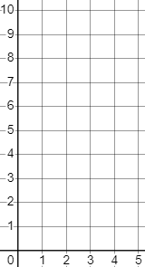
Plotting arithmetic sequences
If we plot these sequences graphically this relationship will be far easier to see.
✖
✖
2n
Term value (T)
Term number (n) | 1 | 2 | 3 | 4 | 5
Term value (T) | 2 | 4 | 6 | 8 | 10
✖
✖
Once plotted we can see why arithmetic sequences are also known as linear sequences. The coordinates are in a straight line.
✖
Term number (n)

Slide 10
Plotting arithmetic sequences
If we plot these sequences graphically this relationship will be far easier to see.
✖
✖
2n
Term value (T)
✖
Term number (n) | 1 | 2 | 3 | 4 | 5
Term value (T) | 2 | 4 | 6 | 8 | 10
✖
✖
✖
✖
✖
n + 2
✖
✖
Term number (n) | 1 | 2 | 3 | 4 | 5
Term value (T) | 3 | 4 | 5 | 6 | 7
Term number (n)

Slide 11
Plotting arithmetic sequences
By representing these sequences graphically we can more clearly see that…
2n
✖
✖
Term value (T)
n + 2
✖
Initially the sequence n + 2 is greater. At the 2nd term they are equal, then for all terms beyond 2n is greater.
✖
✖
✖
✖
✖
✖
✖
Aisha
Term number (n)

Slide 12

Plotting arithmetic sequences
The graph of the sequence 2n.
✖
Term number (n) | 1 | 2 | 3 | 4 | 5
Term value (T) | 2 | 4 | 6 | 8 | 10
✖
Term value (T)
Jun spots the linear pattern, draws a line, and says:
✖
The 2.5th term is 5
✖
✖
What is wrong with his statement?
Term number (n)

Slide 13
Plotting arithmetic sequences
The graph of the sequence 2n.
✖
Term number (n) | 1 | 2 | 3 | 4 | 5
Term value (T) | 2 | 4 | 6 | 8 | 10
✖
Term value (T)
Jun spots the linear pattern, draws a line, and says:
✖
The 2.5th term is 5
✖
5 is not in the sequence.
There is no 2.5th term in this sequence, so we don’t draw a line when plotting them.
n, the term number, has to be a positive integer.
✖
Term number (n)

Slide 14

Plotting arithmetic sequences
What are the missing term values for the sequence 3n + 1?
Term number (n) | 1 | 2 | 3 | 4 | 5
Term value (T) | 4
A 3n sequence has a constant difference of +3
5, 6, 7, 8, …
Term number (n) | 1 | 2 | 3 | 4 | 5
Term value (T) | 4 | 7 | 10 | 13 | 16
6, 9, 12, 15, …
When n = 5
3n + 1 = 3(5) + 1 = 16
7, 10, 13, 16, …

Slide 15
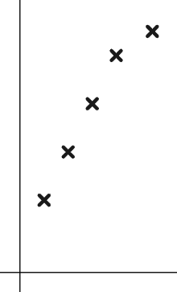
Plotting arithmetic sequences
What term is plotted incorrectly for the sequence 3n + 1?
It’s not in line. In an arithmetic (linear) sequence, the points should be in a straight line.
The 5th
Term value (T)
The 3rd
The 1st
Term number (n)

Slide 16
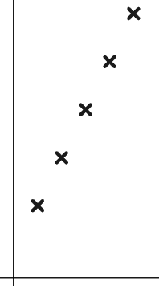
Plotting arithmetic sequences
Once plotted, we draw a line through the coordinates.
T
Because they form a straight line.
We only know specific terms of a sequence.
n

Slide 17
Plotting arithmetic sequences
Complete the term values for these sequences.
8 + 3n
Term number (n) | 1 | 2 | 3 | 4 | 5
Term value (T)
Term number (n) | 1 | 2 | 3 | 4 | 5
Term value (T) | 11 | 14 | 17 | 20 | 23
What is different about the sequence 8 − 3n?
8 − 3n
Term number (n) | 1 | 2 | 3 | 4 | 5
Term value (T)
Term number (n) | 1 | 2 | 3 | 4 | 5
Term value (T) | 5 | 2 | −1 | −4 | −7
The common difference is −3
It is a decreasing sequence.
It has negative terms.

Slide 18
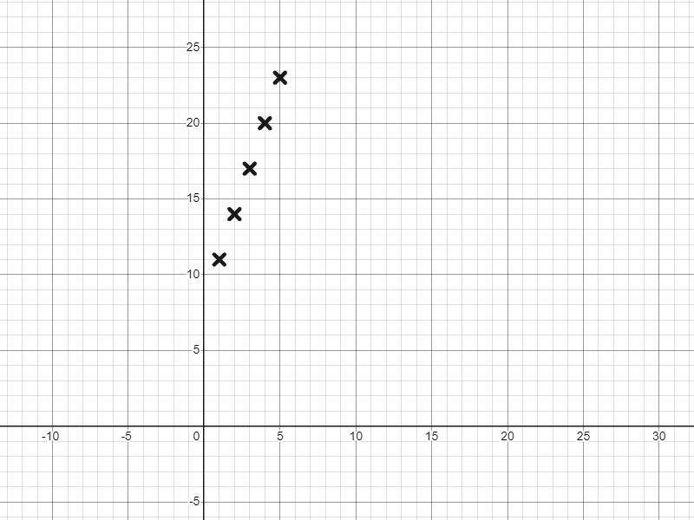
Plotting arithmetic sequences
The graphical representation of…
T
8 + 3n
Term number (n) | 1 | 2 | 3 | 4 | 5
Term value (T)
Term number (n) | 1 | 2 | 3 | 4 | 5
Term value (T) | 11 | 14 | 17 | 20 | 23
An increasing sequence, of constant difference +3
n

Slide 19
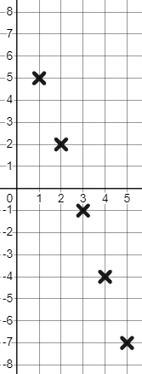
Plotting arithmetic sequences
The graphical representation of…
T
An decreasing sequence, of constant difference −3
n
8 − 3n
Term number (n) | 1 | 2 | 3 | 4 | 5
Term value (T)
Term number (n) | 1 | 2 | 3 | 4 | 5
Term value (T) | 5 | 2 | −1 | −4 | −7

Slide 20
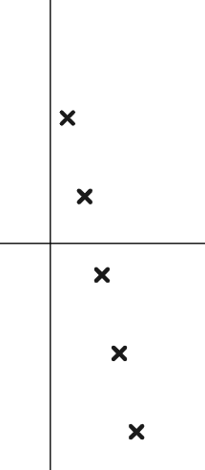
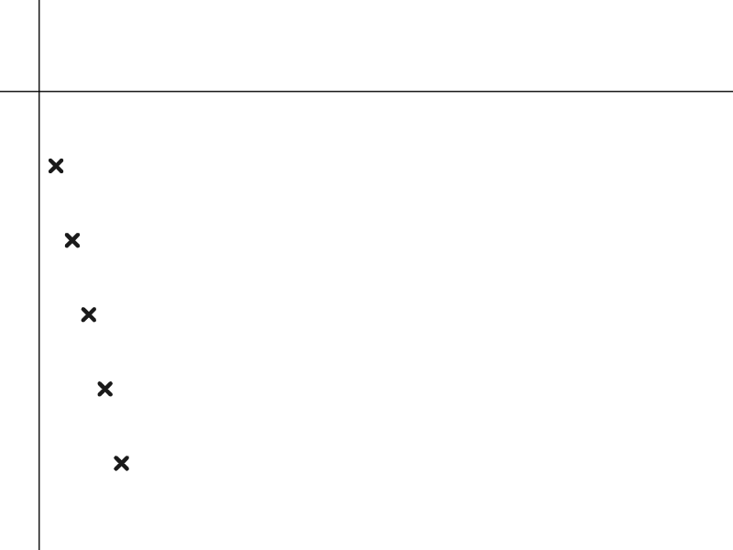
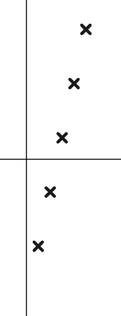
Plotting arithmetic sequences
Which of these could be the graphical representation of the sequence 13 − 5n?
T
T
T
First term of 13 − 5n is positive.
n
−5n will be a decreasing sequence.
n
n

Slide 21
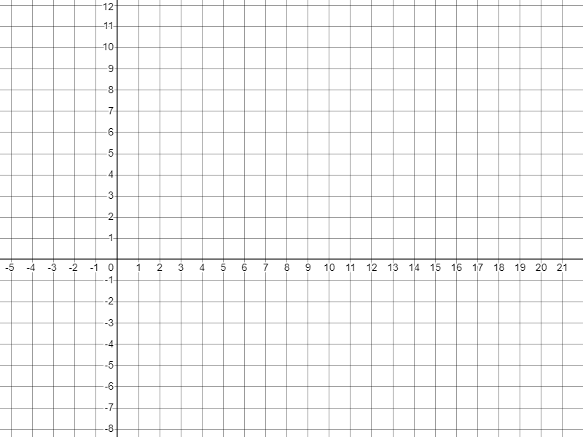
Plotting arithmetic sequences
1) Find and plot the first five terms of these arithmetic sequences.
T
a)
4n − 10
Term number (n) | 1 | 2 | 3 | 4 | 5
Term value (T)
n
b)
10 − n
Term number (n) | 1 | 2 | 3 | 4 | 5
Term value (T)

Slide 22
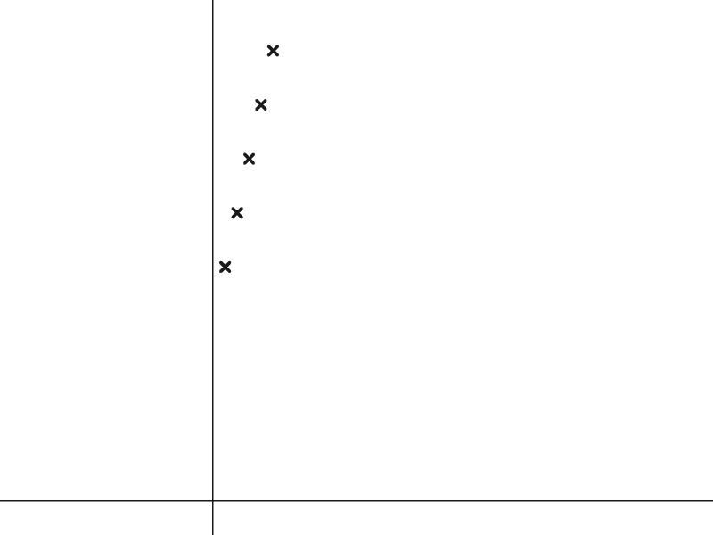
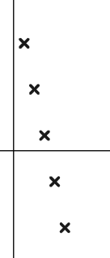
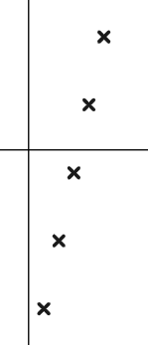
Plotting arithmetic sequences
2) Match the sequences to their graph.
T
T
T
3n − 10
3n + 10
n
n
10 − 3n
n

Slide 23
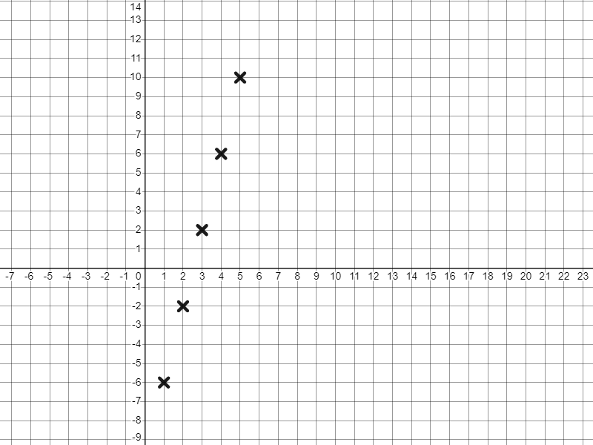
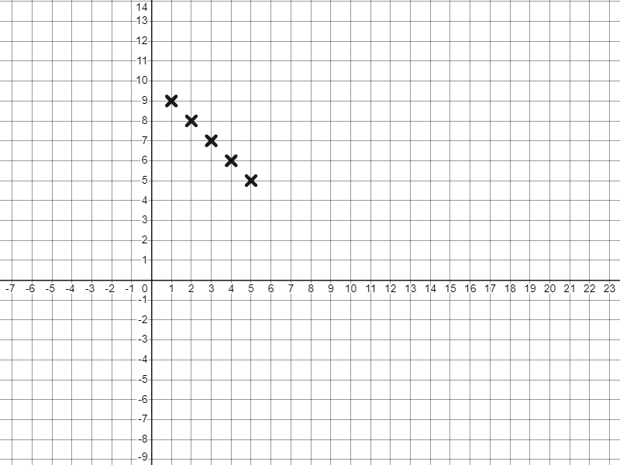
Plotting arithmetic sequences
1) Find and plot the first five terms of these arithmetic sequences.
T
a)
4n − 10
Term number (n) | 1 | 2 | 3 | 4 | 5
Term value (T)
Term number (n) | 1 | 2 | 3 | 4 | 5
Term value (T) | −6 | −2 | 2 | 6 | 10
n
b)
10 − n
Term number (n) | 1 | 2 | 3 | 4 | 5
Term value (T)
Term number (n) | 1 | 2 | 3 | 4 | 5
Term value (T) | 9 | 8 | 7 | 6 | 5

Slide 24
Plotting arithmetic sequences
2) Match the sequences to their graph.
T
3n + 10
T
10 − 3n
T
3n − 10
Decreasing sequence, starting with positive terms.
Increasing sequence, all positive terms.
n
n
Increasing sequence, starting with negative terms.
n

Slide 25
Checking and securing understanding of plotting coordinates generated from a rule
Plotting arithmetic sequences
Plotting coordinates that follow a rule

Slide 26
Plotting coordinates that follow a rule
The arithmetic sequence 2n + 1
Term number (n) | 1 | 2 | 3 | 4 | 5
Term value (T)
Term number (n) | 1 | 2 | 3 | 4 | 5
Term value (T) | 3 | 5 | 7 | 9 | 11
The term numbers are generated by the rule “Multiply n by 2 and add 1”
We can also plot cartesian coordinates related by such rules.
For example, plot y = 2x + 1
x | 1 | 2 | 3 | 4 | 5
y
x | 1 | 2 | 3 | 4 | 5
y | 3 | 5 | 7 | 9 | 11
The y-coordinates are generated by the rule “Multiply x by 2 and add 1”

Slide 27
Plotting coordinates that follow a rule
The arithmetic sequence 2n + 1
Term number (n) | 1 | 2 | 3 | 4 | 5
Term value (T)
Term number (n) | 1 | 2 | 3 | 4 | 5
Term value (T) | 3 | 5 | 7 | 9 | 11
Do you notice any similarities?
The rule y = 2x + 1
They are the same numbers.
x | 1 | 2 | 3 | 4 | 5
y
They both generated an arithmetic (linear) sequence with a common difference +2
x | 1 | 2 | 3 | 4 | 5
y | 3 | 5 | 7 | 9 | 11

Slide 28
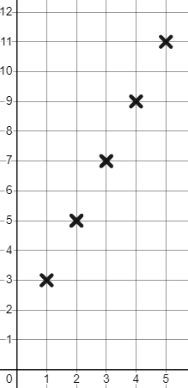
Plotting coordinates that follow a rule
We can represent both graphically.
x | 1 | 2 | 3 | 4 | 5
y
Term number (n) | 1 | 2 | 3 | 4 | 5
Term value (T)
x | 1 | 2 | 3 | 4 | 5
y | 3 | 5 | 7 | 9 | 11
Term number (n) | 1 | 2 | 3 | 4 | 5
Term value (T) | 3 | 5 | 7 | 9 | 11
T
y
2n + 1
y = 2x + 1
So are they the exact same thing?
n, the term number, takes positive integer values when plotting this sequence whereas x can be any value.
n
x

Slide 29

Plotting coordinates that follow a rule
The graph of the rule y = 2x + 1
y
x | 0 |  | 1 | 1.5 | 2 | 2.1 | 2.2 | 3 | 3.61 | 4 | 5
y | 1 | 2 | 3 | 4 | 5 | 5.2 | 5.4 | 7 | 8.22 | 9 | 11
✖
The variable x can take on infinite values.
✖
When graphing this rule linking x and y we do draw a line. The line represents the infinite number of x inputs and their respective y outputs.
✖
✖
✖
✖
x

Slide 30
Plotting coordinates that follow a rule
When plotting the rule y = 3x + 2 we only plot positive integers.
It’s the same as plotting an arithmetic sequence. n has to be a positive integer so x has to be too.
When plotting rules that link the x and y coordinates there are infinite inputs and outputs, not just positive integers.

Slide 31
Plotting coordinates that follow a rule
Fill in this table of values to graph the rule y = 3x − 2
x | −3 | −2 | −1 | 0 | 1 | 2 | 3
y | −11 | −8 | −5 | −2 | 1 | 4 | 7
x | −3 | −2 | −1 | 0 | 1 | 2 | 3
y
Have you spotted a pattern?
Like an arithmetic (linear) sequence, we have a common difference.
We know that the x coordinate can be negative, so negative x values can be input into the rule and plotted.
Check!
y = 3x − 2
But you might find it easiest to calculate the zero and positive values first.
= 3(−3) − 2
= −9 − 2 = −11

Slide 32
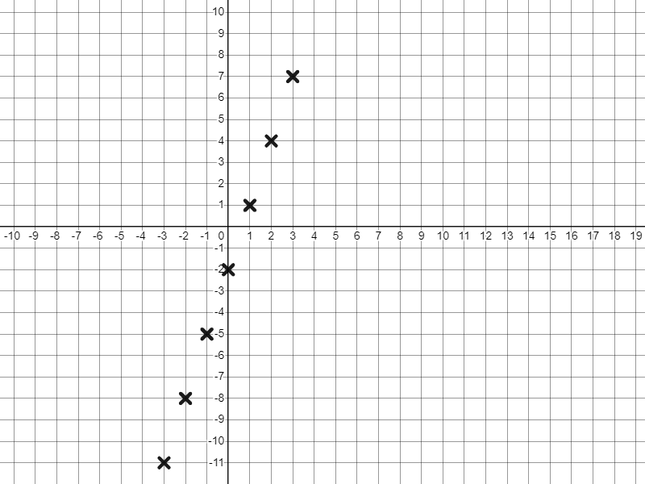
Plotting coordinates that follow a rule
y
The rule y = 3x − 2
x | −3 | −2 | −1 | 0 | 1 | 2 | 3
y | −11 | −8 | −5 | −2 | 1 | 4 | 7
x | −3 | −2 | −1 | 0 | 1 | 2 | 3
y
x
Unlike arithmetic sequences we are now plotting in more than two quadrants.
x has infinite inputs so we draw a line through all points, and beyond our last points to reflect that.

Slide 33
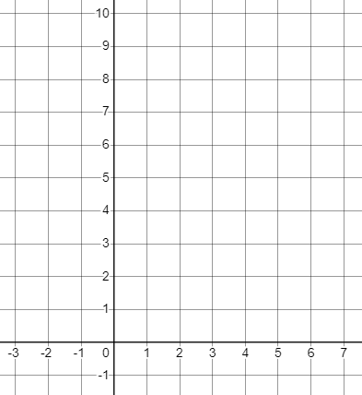
Plotting coordinates that follow a rule
Complete the table of values to plot the rule y = 5 − x
y
x | −3 | −2 | −1 | 0 | 1 | 2 | 3 | 4 | 5 | 6
y |  |  | 6 |  |  | 3 |  | 1
Some values are already done for you.
x

Slide 34
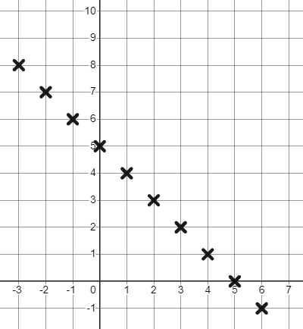
Plotting coordinates that follow a rule
Complete the table of values to plot the rule y = 5 − x
y
x | −3 | −2 | −1 | 0 | 1 | 2 | 3 | 4 | 5 | 6
y | 8 | 7 | 6 | 5 | 4 | 3 | 2 | 1 | 0 | −1
x

Slide 35
Plotting coordinates that follow a rule
Complete the table of values to plot the rule y = 5 − x
y
x | −3 | −2 | −1 | 0 | 1 | 2 | 3 | 4 | 5 | 6
y | 8 | 7 | 6 | 5 | 4 | 3 | 2 | 1 | 0 | −1
Did our table of values have to be in consecutive integer order for us to be able to plot the rule y = 5 − x ?
x

Slide 36
Plotting coordinates that follow a rule
Complete the table of values to plot the rule y = 5 − x
y
x | 0.5 | −0.5 |  | 1.75
y | 4.5 | 5.5 |  | 3.25
3
1
✖
✖
Any x value input into the rule will generate this same linear pattern.
✖
✖
x

Slide 37
Plotting coordinates that follow a rule
1) Match the verbal rule to the simplified algebraic rule.
y = x + 3
The x-coordinate multiplied by 5 subtracted from 3
y = 3x + 5
Add 3 to the x-coordinate
y = 5x − 3
The x-coordinate multiplied by 5 add 3
y = 5x + 3
The x-coordinate subtracted from 3
y = 3 − 5x
The x-coordinate multiplied by 5 subtract 3
y = 3 − x
The x-coordinate multiplied by 3 add 5

Slide 38
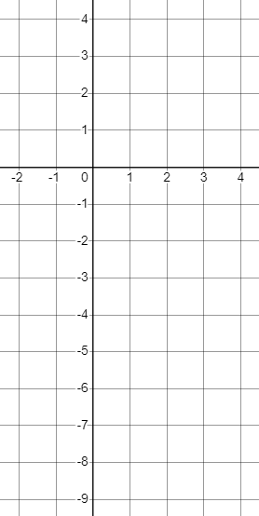
Plotting coordinates that follow a rule
2) Complete the table of values and plot the rules:
y
a) y = 2x − 5
x | −2 | −1 | 0 | 1 | 2 | 3 | 4
y |  | −7 |  |  |  | 1
x
b) y = 1 − x
x | −2 | −1 | 0 | 1 | 2 | 3 | 4
y |  |  | 1 |  | −1

Slide 39
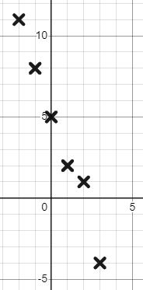

Plotting coordinates that follow a rule
3) Jacob plots the rule y = 5 − 3x
y
x | −2 | −1 | 0 | 1 | 2 | 3
y | 11 | 8 | 5 | 2 | 1 | −4
Mark his work and give him feedback.
x

Slide 40
Plotting coordinates that follow a rule
1) Match the verbal rule to the simplified algebraic rule.
y = x + 3
The x-coordinate multiplied by 5 subtracted from 3
y = 3x + 5
Add 3 to the x-coordinate
y = 5x − 3
The x-coordinate multiplied by 5 add 3
y = 5x + 3
The x-coordinate subtracted from 3
y = 3 − 5x
The x-coordinate multiplied by 5 subtract 3
y = 3 − x
The x-coordinate multiplied by 3 add 5

Slide 41
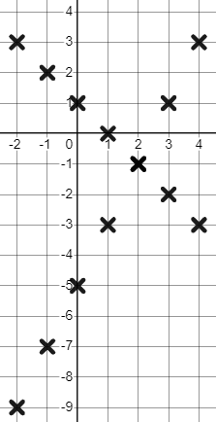
Plotting coordinates that follow a rule
2) Complete the table of values and plot the rules:
y
a) y = 2x − 5
x | −2 | −1 | 0 | 1 | 2 | 3 | 4
y |  | −7 |  |  |  | 1
x | −2 | −1 | 0 | 1 | 2 | 3 | 4
y | −9 | −7 | −5 | −3 | −1 | 1 | 3
x
b) y = 1 − x
x | −2 | −1 | 0 | 1 | 2 | 3 | 4
y |  |  | 1 |  | −1
x | −2 | −1 | 0 | 1 | 2 | 3 | 4
y | 3 | 2 | 1 | 0 | −1 | −2 | −3

Slide 42
Plotting coordinates that follow a rule
3) Jacob plots the rule y = 5 − 3x
y
x | −2 | −1 | 0 | 1 | 2 | 3
y | 11 | 8 | 5 | 2 | 1 | −4
Mark his work and give him feedback.
y = 5 − 3x is a linear rule, this should make a straight line.
This coordinate (2, 1) does not fit the rule. 5 − 3(2) = −1, plot (2, −1) instead.
x
Also, continue your lines to the edge of your grid.

Slide 43
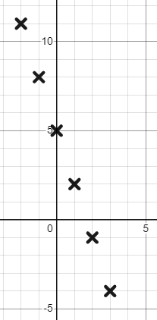
Plotting coordinates that follow a rule
3) Jacob plots the rule y = 5 − 3x
y
x | −2 | −1 | 0 | 1 | 2 | 3
y | 11 | 8 | 5 | 2 | −1 | −4
y = 5 − 3x is a linear rule, this should make a straight line.
This coordinate (2, 1) does not fit the rule. 5 − 3(2) = −1, plot (2, −1) instead.
x
Also, continue your lines to the edge of your grid.

Slide 44
Checking and securing understanding of plotting coordinates generated from a rule.
y
We can represent mathematical rules graphically and algebraically.
We do this graphically by plotting coordinates that fit our rule.
E.g. the graph shows the algebraic relationship y = 3x − 2
x

Slide 45

© Oak National Academy 2023.
Produced in partnership with Mathematics in Education and Industry.
Licensed on the Open Government Licence v3.0, except where otherwise stated. See Oak terms and conditions.

